Slide 1

Health care LOGISTICS
EP SKILLING
Batch Number-10

Slide 2
ABSTRACT
The purpose of designing this web-based application , for a healthcare logistics is to maintain a record of its tests and technicians.
So that , A logistics and technicians tracking website that allows a customer to search for all the booking date time and location , Technicians assigned for a booking , also allows customers to check the logistics used for bookings .

Slide 3
Modules included in this project
Manager
Technicians
Customer

Slide 4
modules
Manager Module
In this Module ,Manager can do the following tasks
login
Add Equipment
Add Tests
View Equipment
View Tests
View Technician
View Customer
Total Tests
Logout

Slide 5
modules
2) Technicians Module
In this Module ,Technicians can do the following tasks
Register
View Customer Details
add customer details
Logout

Slide 6
modules
3) Customer Module
In this Module ,Customer can do the following tasks
register
Login
Book Technicians
View Bills
Logout

Slide 7
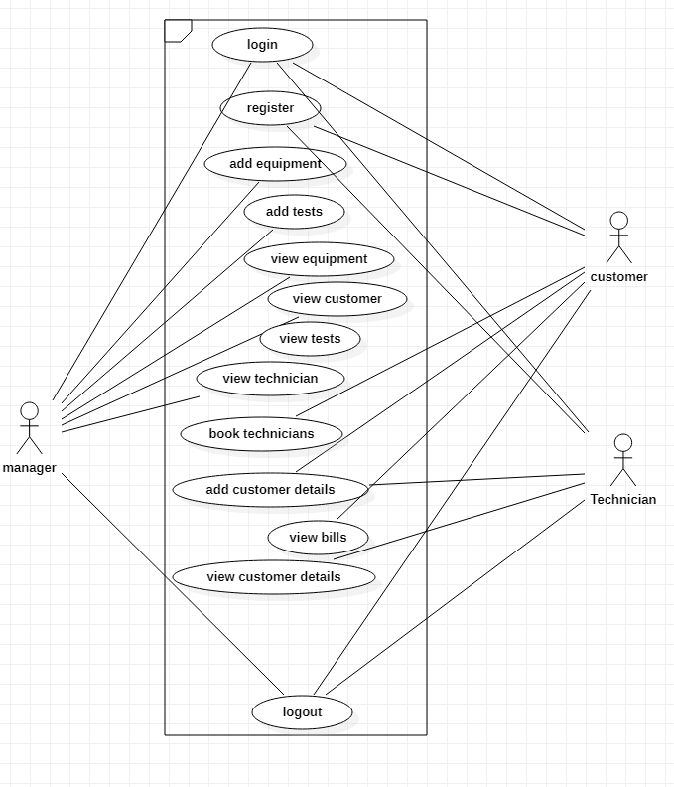
USE CASE DIAGRAM

Slide 8
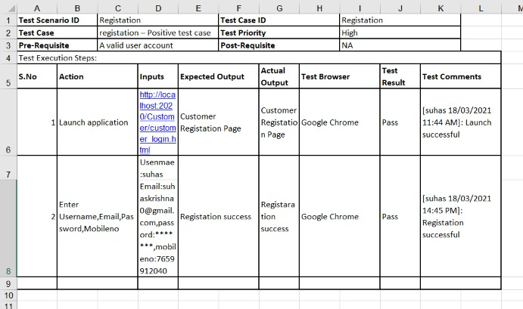
Testing approach for registration

Slide 9
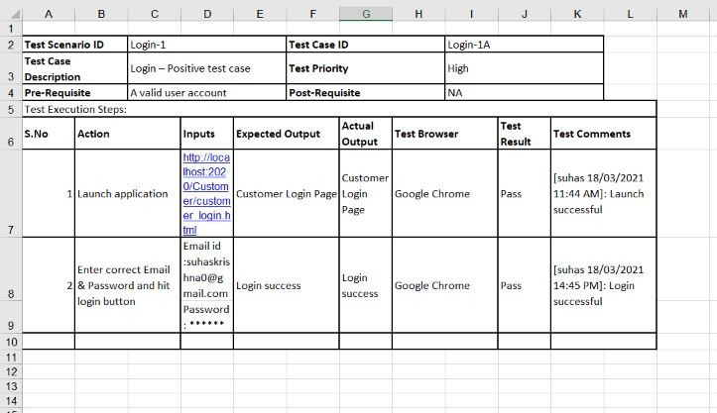
TESTING APPROACH FOR login PAGE

Slide 10
TESTING APPROACH
A test approach is the test strategy implementation of a project, defines how testing would be carried out. As soon as iteration is completed , the entire system is subjected to testing . Feedback from testing is immediately available . The testing time required in successive iteration can be reduced based on the experience gained from past iterations

Slide 11
TESTING APPROACH
Black Box Testing is a software testing method in which the internal structure/ design/ implementation of the item being tested is not known to the tester. (need to test )
White Box Testing is a software testing method in which the internal structure/ design/ implementation of the item being tested is known to the tester. (need to test )
JUnit Testing (need to work)

Slide 12


Slide 13
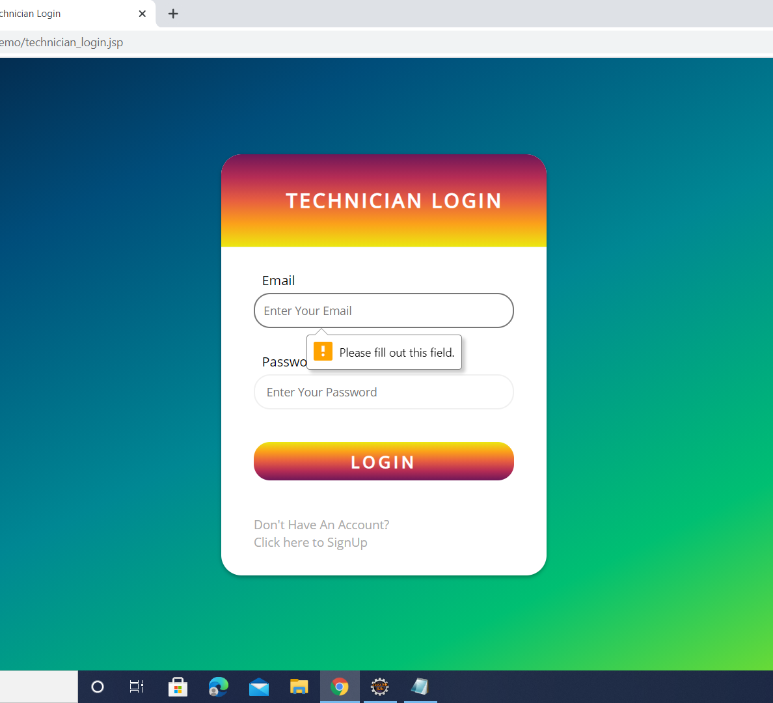
VALIDATIONS
For example:
When we directly click on login it will show like "please fill out this field" for both the fields

Slide 14
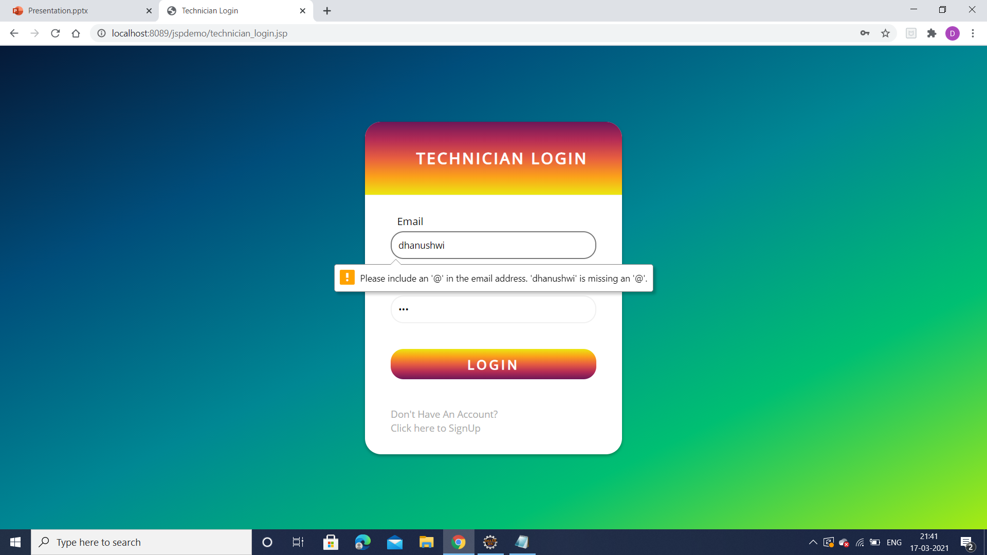

Slide 15
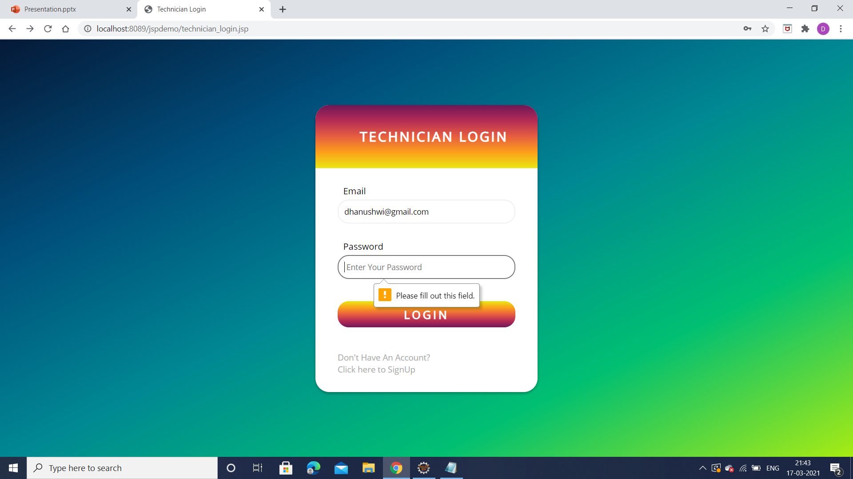

Slide 16
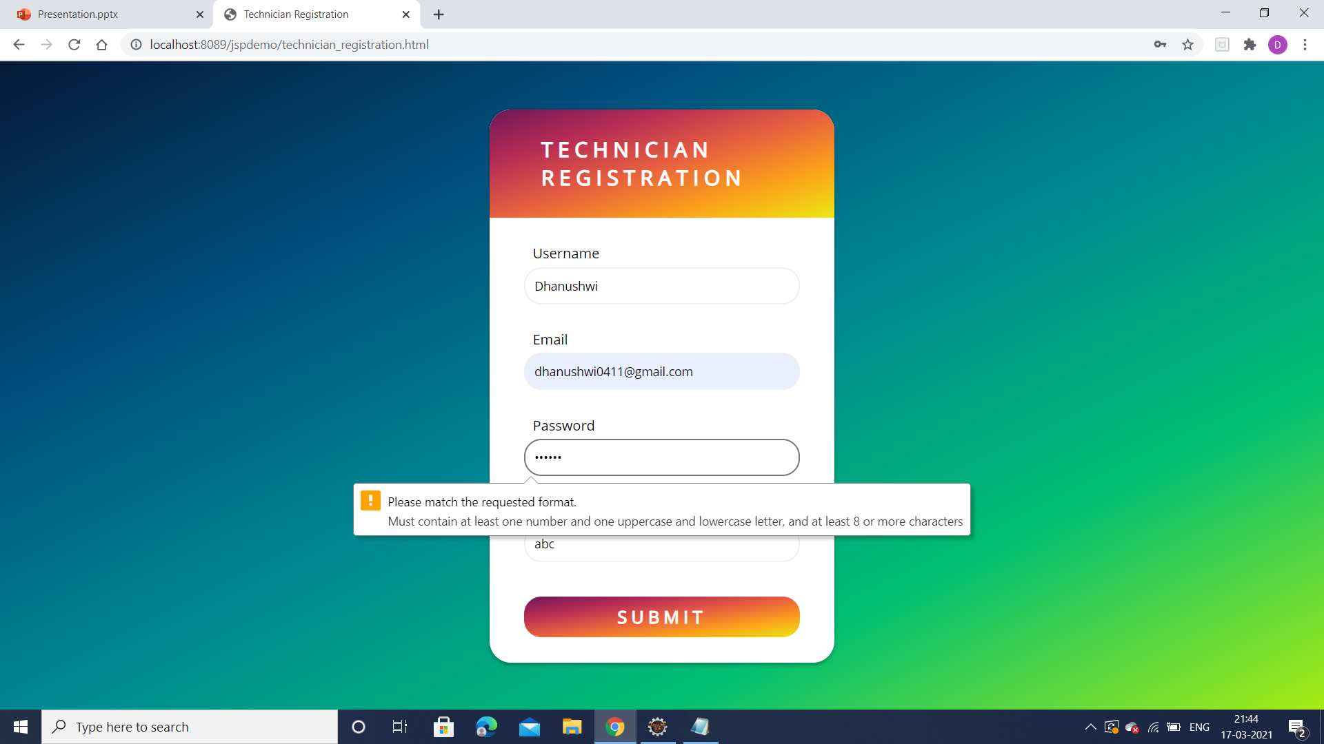

Slide 17
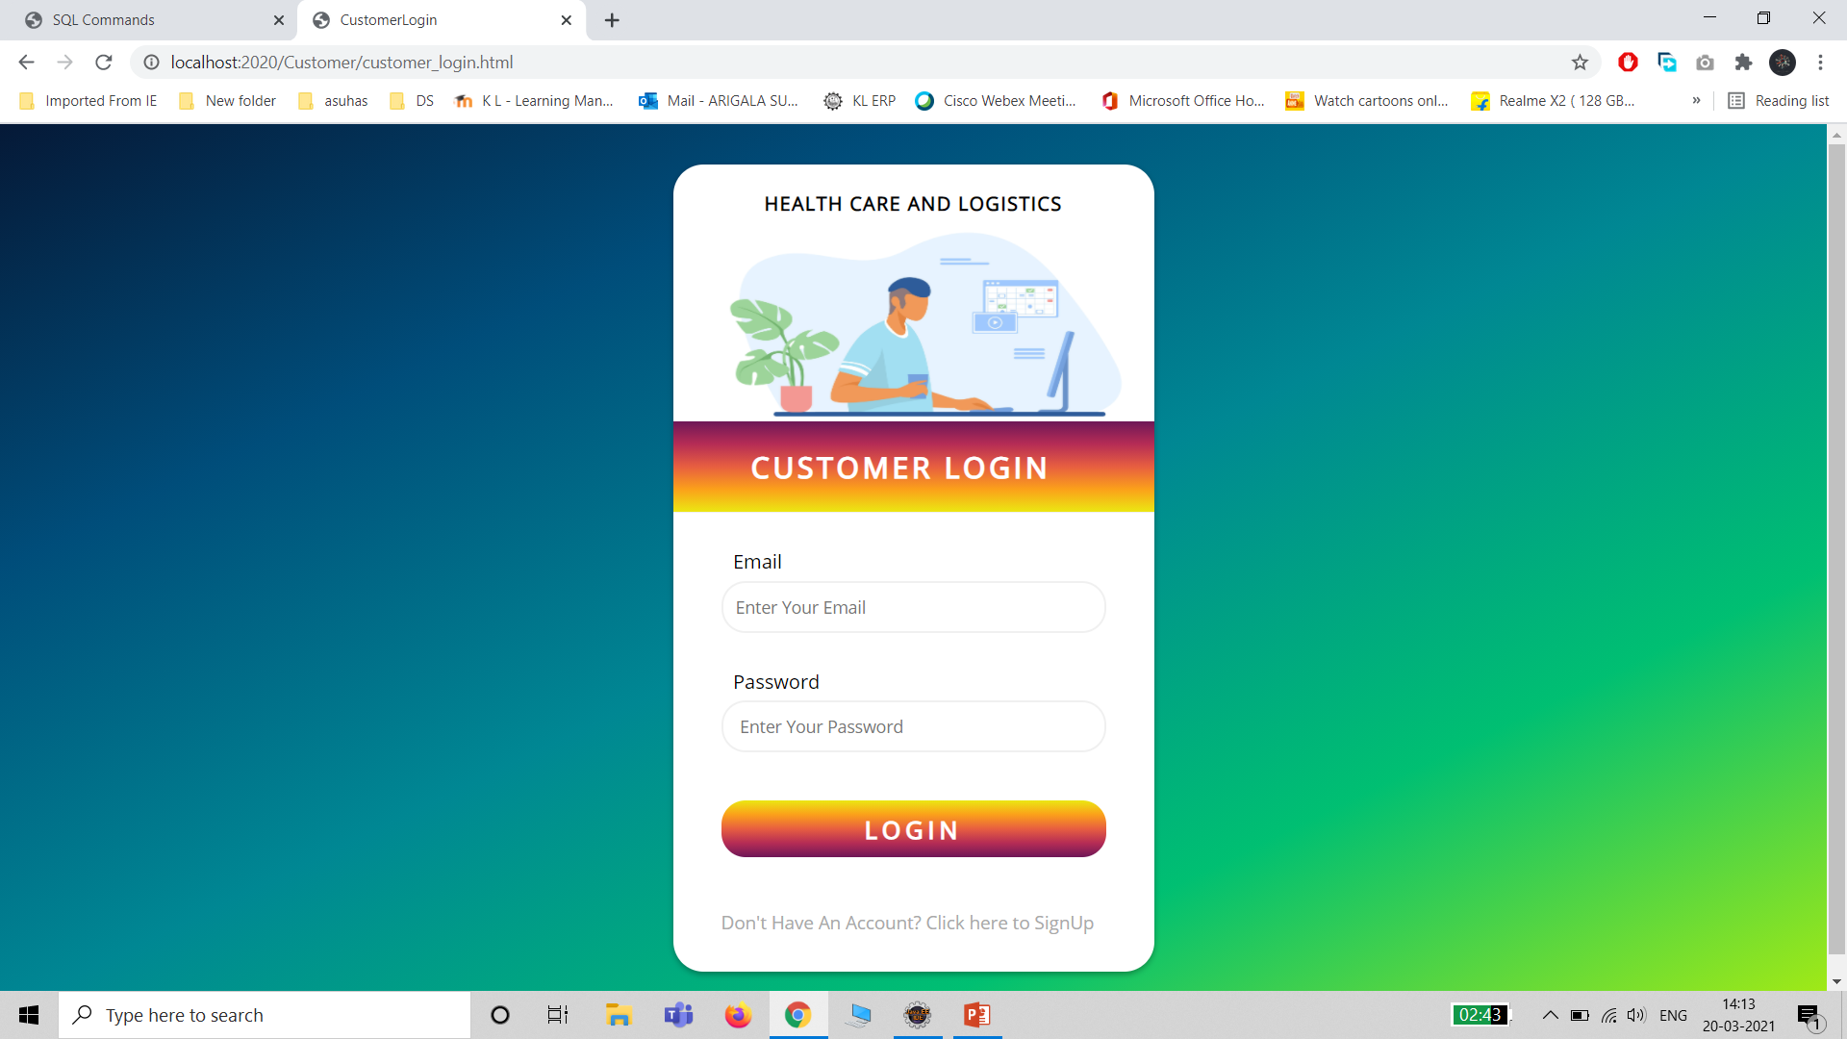

Slide 18
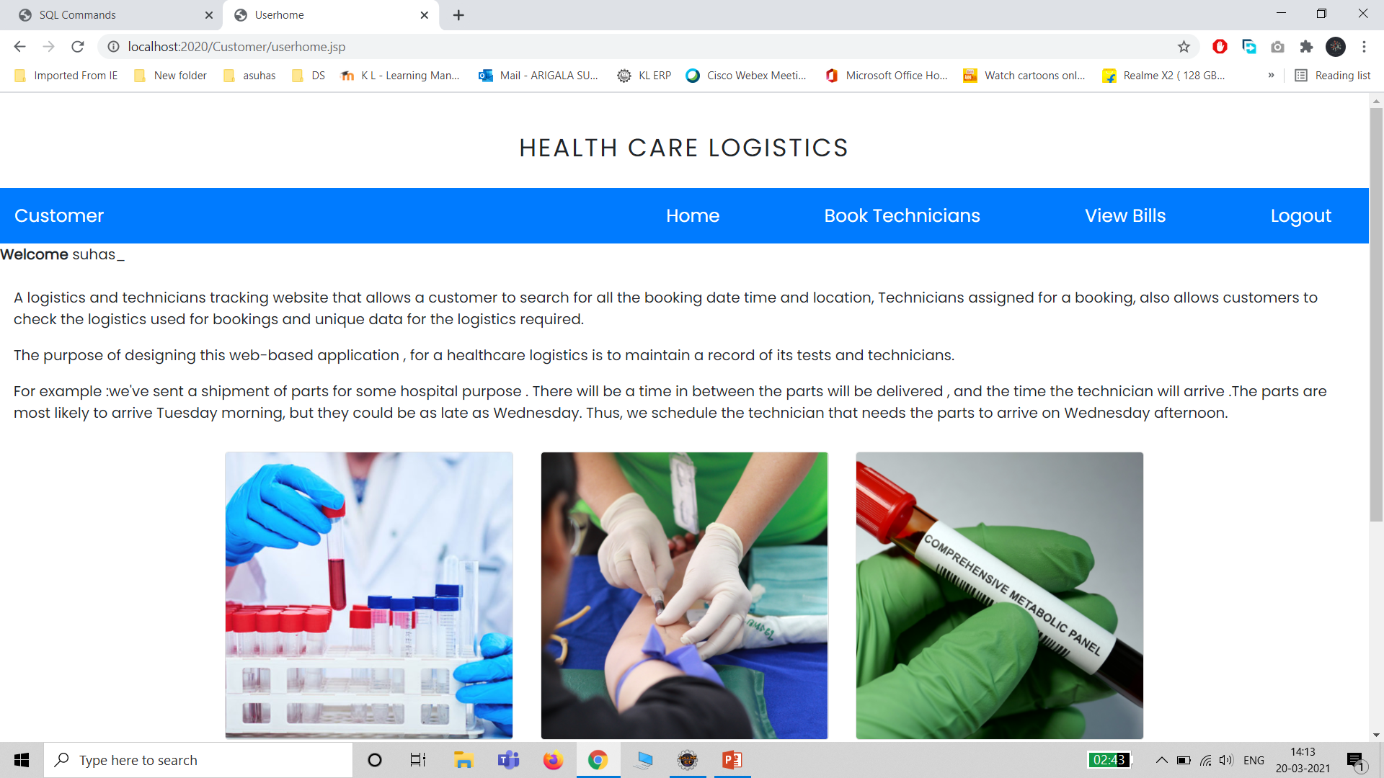

Slide 19
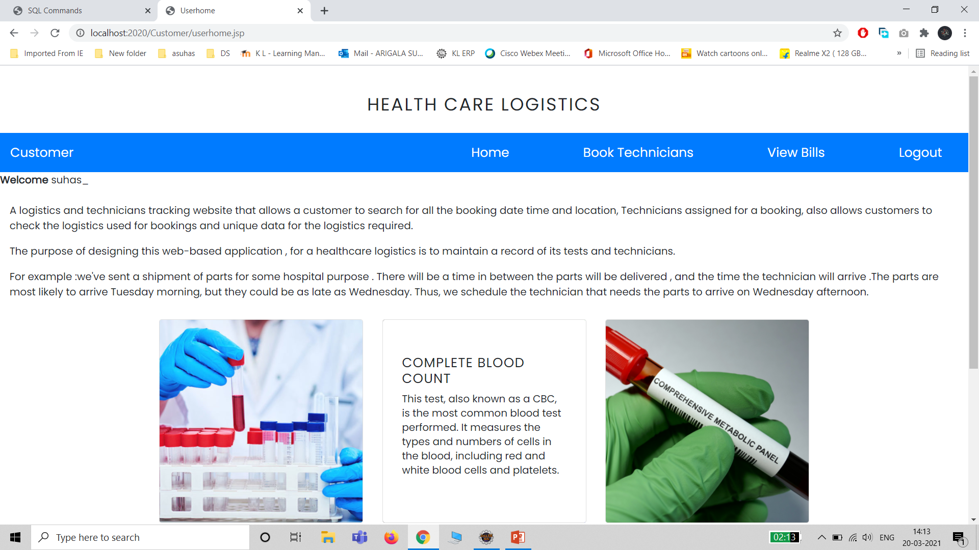

Slide 20
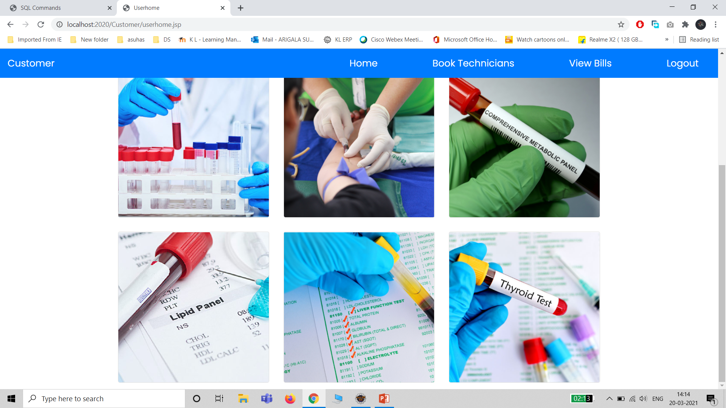

Slide 21
THANK YOU

